Slide 1
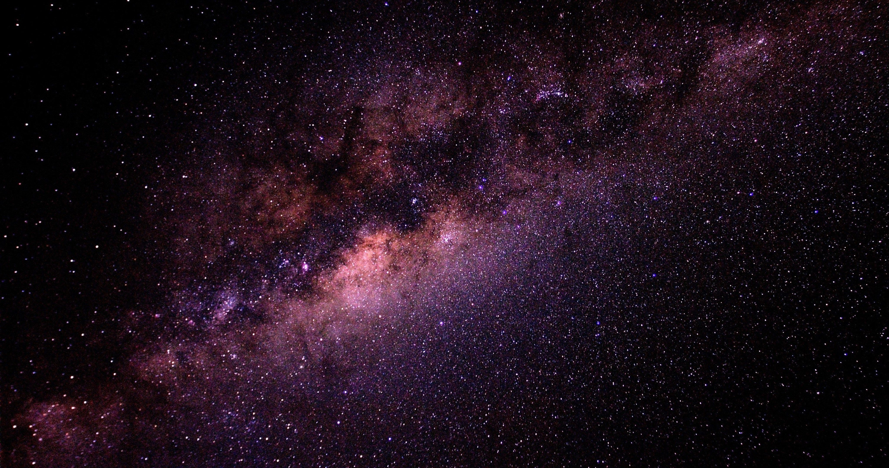

COSMIC VOYAGER
-A Space Blog

Slide 2
Humans have always looked up into the night sky and dreamed about space. For centuries astronomers and many astrophysicists have worked together to solve the mysteries of space.
The advancement of technology has not only proved many theories but we have also successfully discovered many aspects in this voyage of mystery solving.

Slide 3
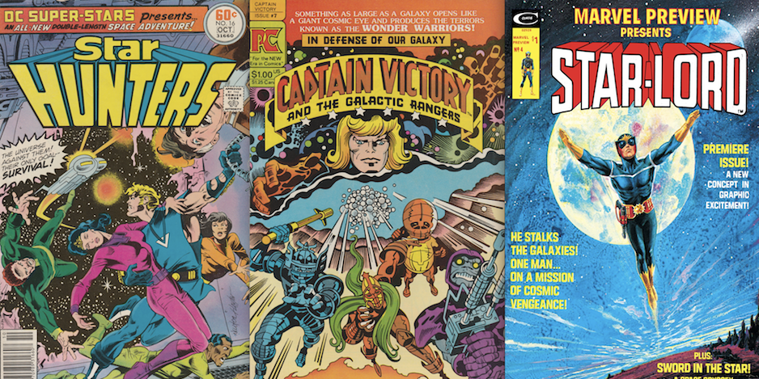

The journey from Comic books and Science Fiction Movies
TO
Working for organizations like NASA, ISRO etc

Slide 4
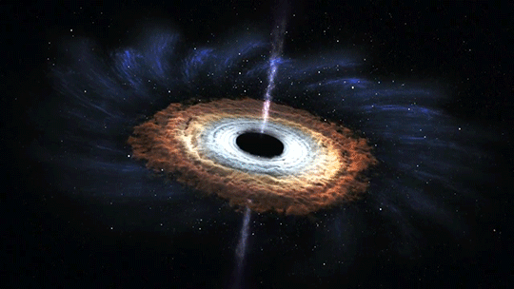
Our project aims to quench the thirst for knowledge by helping children learn about the Universe.
They can learn about -
formation of black-holes
planets
galaxies
Fun facts about the universe
Mail updates of interesting facts can be received by registering on the website.

Slide 5
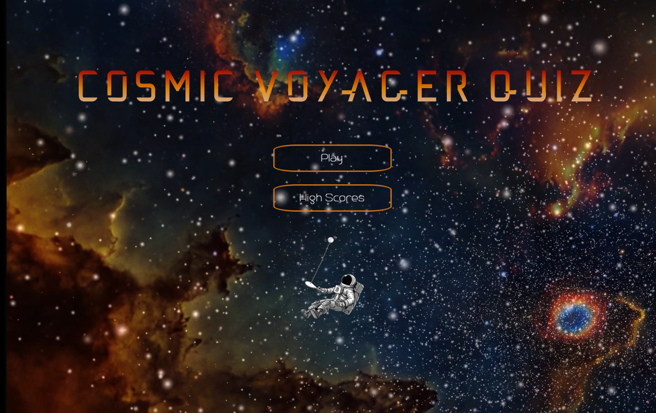
Take up the Cosmic Voyager Quiz to see what you know.

Slide 6







TECHNOLOGIES
USED
HTML 5
PHP
MY SQL
CSS
JSON
NODE JS
JAVA SCRIPT

Slide 7

THANK YOU

